Slide 1
This Talk
1) Node embeddings
Map nodes to low-dimensional embeddings.
2) Graph neural networks
Deep learning architectures for graph-structured data
3) Applications

Slide 2
Part 2:
Graph Neural Networks

Slide 3
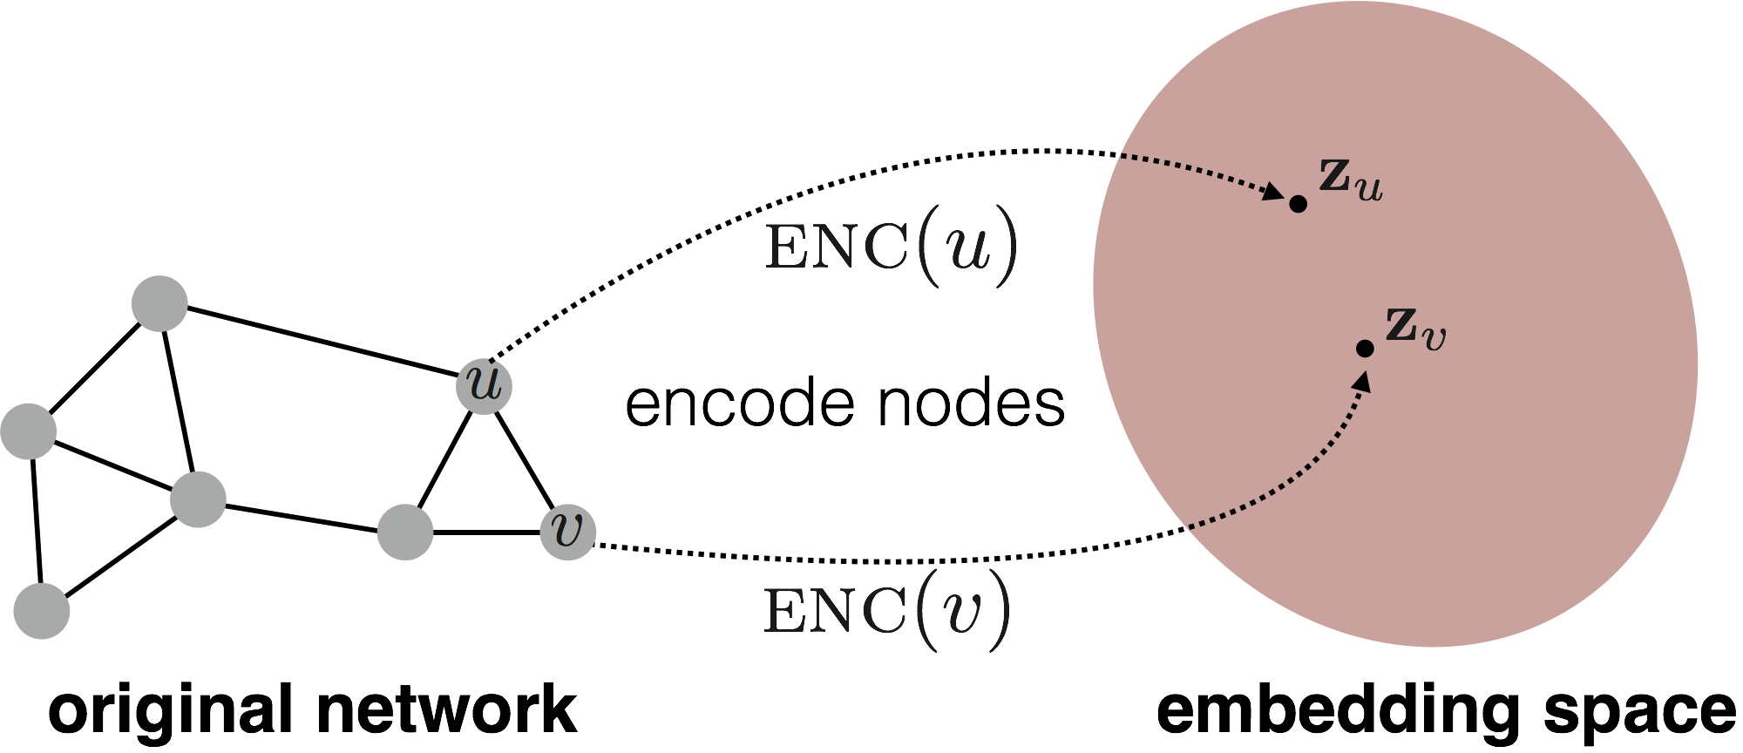
Embedding Nodes
Goal is to encode nodes so that similarity in the embedding space (e.g., dot product) approximates similarity in the original network.

Slide 4
Embedding Nodes
Goal:
Need to define!

Slide 5
Two Key Components
Encoder maps each node to a low-dimensional vector.
Similarity function specifies how relationships in vector space map to relationships in the original network.
d-dimensional embedding
node in the input graph
Similarity of u and v in the original network
dot product between node embeddings
Notes:
Note again that other distance measures other than dot products could be used (e.g., Euclidean distance), but the dot product is the standard measure of similarity used.

Slide 6
From “Shallow” to “Deep”
So far we have focused on “shallow” encoders, i.e. embedding lookups:
embedding vector for a specific node
embedding matrix
Dimension/size of embeddings
one column per node

Slide 7
From “Shallow” to “Deep”
Limitations of shallow encoding:
O(|V|) parameters are needed: there no parameter sharing and every node has its own unique embedding vector.
Inherently “transductive”: It is impossible to generate embeddings for nodes that were not seen during training.
Do not incorporate node features: Many graphs have features that we can and should leverage.

Slide 8
From “Shallow” to “Deep”
We will now discuss “deeper” methods based on graph neural networks.
In general, all of these more complex encoders can be combined with the similarity functions from the previous section.
complex function that depends on graph structure.

Slide 9
Outline for this Section
We will now discuss “deeper” methods based on graph neural networks.
The Basics
Graph Convolutional Networks (GCNs)
GraphSAGE
Gated Graph Neural Networks
Subgraph Embeddings

Slide 10
The Basics: Graph Neural Networks
Based on material from:
Hamilton et al. 2017. Representation Learning on Graphs: Methods and Applications. IEEE Data Engineering Bulletin on Graph Systems.
Scarselli et al. 2005. The Graph Neural Network Model. IEEE Transactions on Neural Networks.

Slide 11
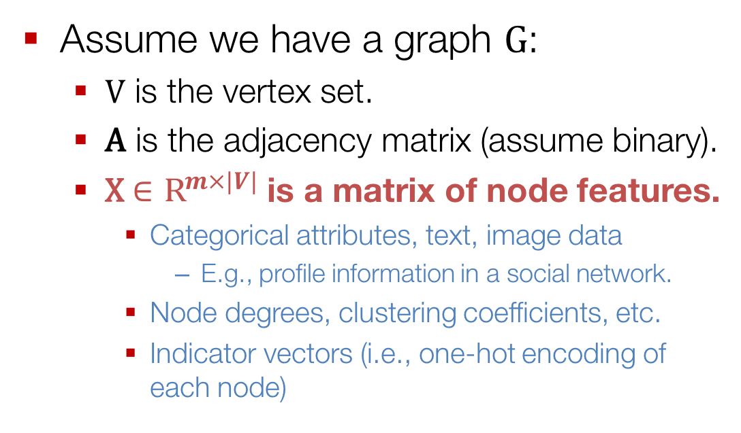
Setup
Assume we have a graph G:
V is the vertex set.
A is the adjacency matrix (assume binary).
X $∈{\text{R}}^{m×|V|}$ is a matrix of node features.
Categorical attributes, text, image data
E.g., profile information in a social network.
Node degrees, clustering coefficients, etc.
Indicator vectors (i.e., one-hot encoding of each node)

Slide 12
Neighborhood Aggregation
Key idea: Generate node embeddings based on local neighborhoods.

Slide 13
Neighborhood Aggregation
Intuition: Nodes aggregate information from their neighbors using neural networks

Slide 14
Neighborhood Aggregation
Intuition: Network neighborhood defines a computation graph
Every node defines a unique computation graph!

Slide 15
Neighborhood Aggregation
Nodes have embeddings at each layer.
Model can be arbitrary depth.
“layer-0” embedding of node u is its input feature, i.e. x_{u}.
Layer-0
Layer-1
Layer-2

Slide 16
Neighborhood “Convolutions”
Neighborhood aggregation can be viewed as a center-surround filter.
Mathematically related to spectral graph convolutions (see Bronstein et al., 2017)

Slide 17
Neighborhood Aggregation
Key distinctions are in how different approaches aggregate information across the layers.
what’s in the box!?
?
???
?
?

Slide 18
Neighborhood Aggregation
Basic approach: Average neighbor information and apply a neural network.
1) average messages from neighbors
2) apply neural network

Slide 19
The Math
Basic approach: Average neighbor messages and apply a neural network.
Initial “layer 0” embeddings are equal to node features
previous layer embedding of v
kth layer embedding of v
non-linearity (e.g., ReLU or tanh)
average of neighbor’s previous layer embeddings

Slide 20
Training the Model
How do we train the model to generate “high-quality” embeddings?
Need to define a loss function on the embeddings, L(z_{u})!

Slide 21
Training the Model
trainable matrices (i.e., what we learn)
After K-layers of neighborhood aggregation, we get output embeddings for each node.
We can feed these embeddings into any loss function and run stochastic gradient descent to train the aggregation parameters.

Slide 22
Training the Model
Train in an unsupervised manner using only the graph structure.
Unsupervised loss function can be anything from the last section, e.g., based on
Random walks (node2vec, DeepWalk)
Graph factorization
i.e., train the model so that “similar” nodes have similar embeddings.

Slide 23
Training the Model
Alternative: Directly train the model for a supervised task (e.g., node classification):
Human or bot?
Human or bot?
e.g., an online social network

Slide 24
Training the Model
Alternative: Directly train the model for a supervised task (e.g., node classification):
classification weights
Human or bot?
output node embedding
node class label

Slide 25
Overview of Model Design
1) Define a neighborhood aggregation function.
2) Define a loss function on the embeddings, L(z_{u})

Slide 26
Overview of Model Design
3) Train on a set of nodes, i.e., a batch of compute graphs

Slide 27
Overview of Model
4) Generate embeddings for nodes as needed
Even for nodes we never trained on!!!!

Slide 28
Inductive Capability
The same aggregation parameters are shared for all nodes.
The number of model parameters is sublinear in |V| and we can generalize to unseen nodes!

Slide 29
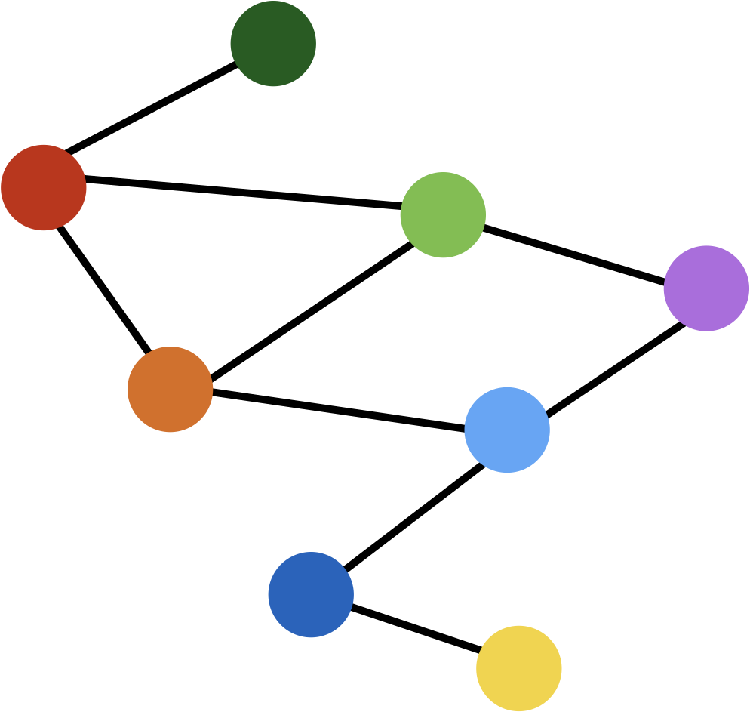
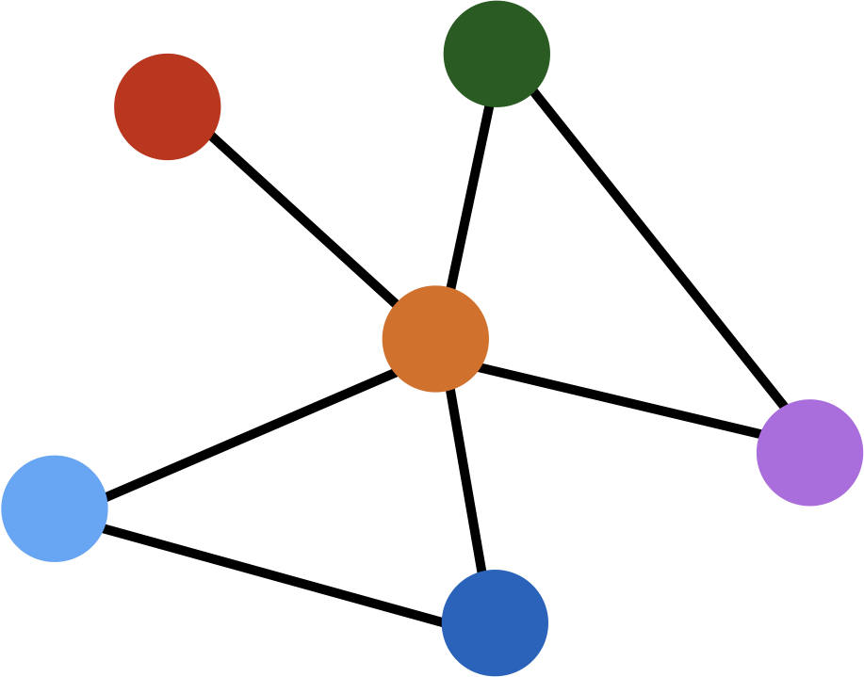
Inductive Capability
train on one graph
generalize to new graph
Inductive node embedding generalize to entirely unseen graphs
e.g., train on protein interaction graph from model organism A and generate embeddings on newly collected data about organism B

Slide 30
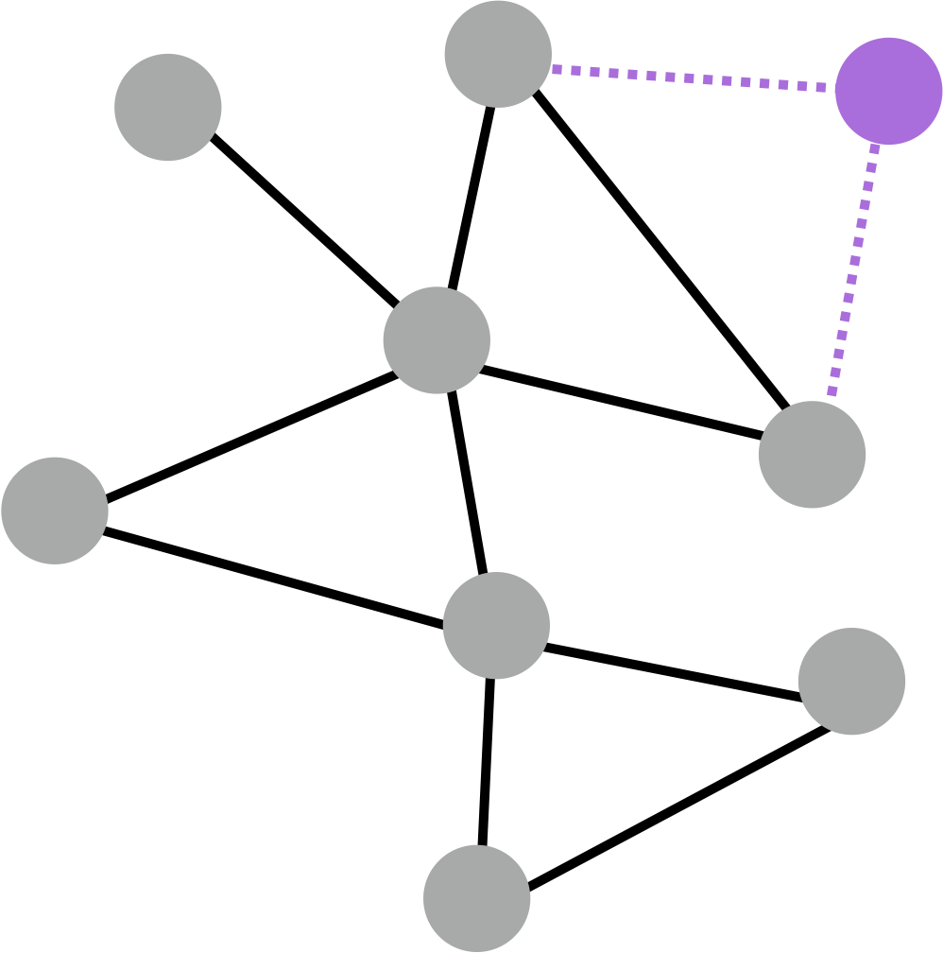
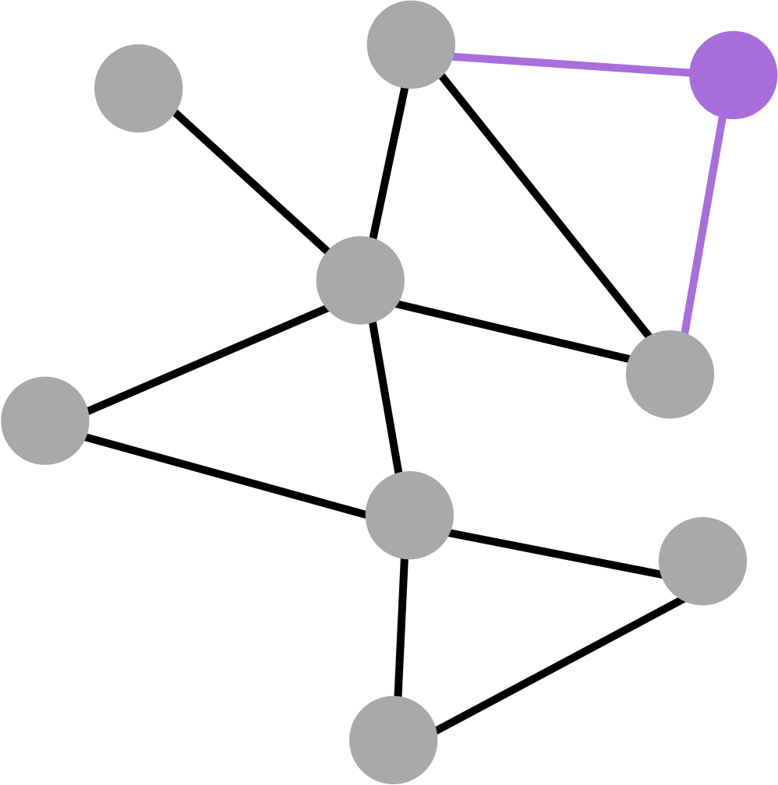
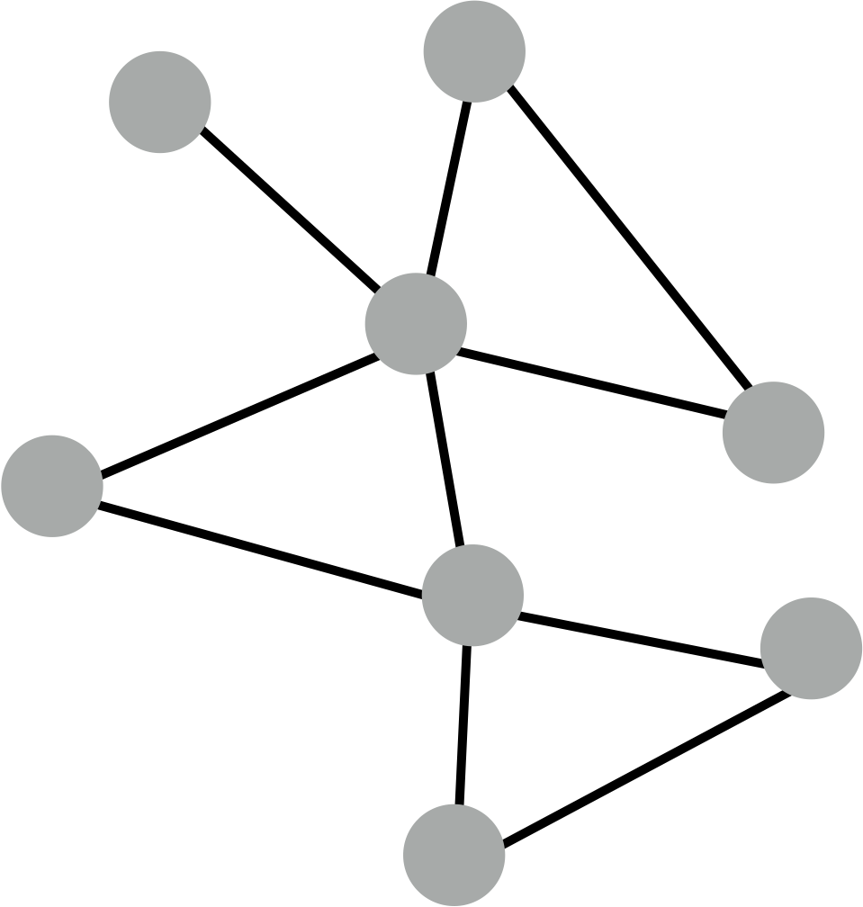
Inductive Capability
generate embedding for new node
train with snapshot
new node arrives
Many application settings constantly encounter previously unseen nodes.
e.g., Reddit, YouTube, GoogleScholar, ….
Need to generate new embeddings “on the fly”

Slide 31
Quick Recap
Recap: Generate node embeddings by aggregating neighborhood information.
Allows for parameter sharing in the encoder.
Allows for inductive learning.
We saw a basic variant of this idea… now we will cover some state of the art variants from the literature.

Slide 32
Neighborhood Aggregation
Key distinctions are in how different approaches aggregate messages
What else can we put in the box?
?
???
?
?

Slide 33
Outline for this Section
The Basics
Graph Convolutional Networks
GraphSAGE
Gated Graph Neural Networks
Subgraph Embeddings

Slide 34
Graph Convolutional Networks
Based on material from:
Kipf et al., 2017. Semisupervised Classification with Graph Convolutional Networks. ICLR.
Notes:
~20mins

Slide 35
Graph Convolutional Networks
Kipf et al.’s Graph Convolutional Networks (GCNs) are a slight variation on the neighborhood aggregation idea:

Slide 36
Graph Convolutional Networks
Basic Neighborhood Aggregation
VS.
GCN Neighborhood Aggregation
same matrix for self and neighbor embeddings
per-neighbor normalization

Slide 37
Graph Convolutional Networks
Empirically, they found this configuration to give the best results.
More parameter sharing.
Down-weights high degree neighbors.
use the same transformation matrix for self and neighbor embeddings
instead of simple average, normalization varies across neighbors

Slide 38
Batch Implementation
Can be efficiently implemented using sparse batch operations:
O(|E|) time complexity overall.
where

Slide 39
Outline for this Section
The Basics
Graph Convolutional Networks
GraphSAGE
Gated Graph Neural Networks
Subgraph Embeddings

Slide 40
GraphSAGE
Based on material from:
Hamilton et al., 2017. Inductive Representation Learning on Large Graphs. NIPS.

Slide 41
GraphSAGE Idea
So far we have aggregated the neighbor messages by taking their (weighted) average, can we do better?
?
???
?
?

Slide 42
GraphSAGE Idea
Any differentiable function that maps set of vectors to a single vector.

Slide 43
GraphSAGE Differences
Simple neighborhood aggregation:
GraphSAGE:
concatenate self embedding and neighbor embedding
generalized aggregation

Slide 44
GraphSAGE Variants
Mean:
Pool
Transform neighbor vectors and apply symmetric vector function.
LSTM:
Apply LSTM to random permutation of neighbors.
element-wise mean/max

Slide 45
Outline for this Section
The Basics
Graph Convolutional Networks
GraphSAGE
Gated Graph Neural Networks
Subgraph Embeddings

Slide 46
Gated Graph Neural Networks
Based on material from:
Li et al., 2016. Gated Graph Sequence Neural Networks. ICLR.

Slide 47
Neighborhood Aggregation
Basic idea: Nodes aggregate “messages” from their neighbors using neural networks

Slide 48
Neighborhood Aggregation
GCNs and GraphSAGE generally only 2-3 layers deep.

Slide 49
Neighborhood Aggregation
But what if we want to go deeper?
10+ layers!?

Slide 50
Gated Graph Neural Networks
How can we build models with many layers of neighborhood aggregation?
Challenges:
Overfitting from too many parameters.
Vanishing/exploding gradients during backpropagation.
Idea: Use techniques from modern recurrent neural networks!

Slide 51
Gated Graph Neural Networks
Idea 1: Parameter sharing across layers.
same neural network across layers

Slide 52
Gated Graph Neural Networks
Idea 2: Recurrent state update.
RNN module!
RNN module

Slide 53
The Math
Intuition: Neighborhood aggregation with RNN state update.
Get “message” from neighbors at step k:
Update node “state” using Gated Recurrent Unit (GRU). New node state depends on the old state and the message from neighbors:
aggregation function does not depend on k

Slide 54
Gated Graph Neural Networks
RNN module
Can handle models with >20 layers.
Most real-world networks have small diameters (e.g., less than 7).
Allows for complex information about global graph structure to be propagated to all nodes.

Slide 55
Gated Graph Neural Networks
RNN module
Useful for complex networks representing:
Logical formulas.
Programs.

Slide 56
Outline for this Section
The Basics
Graph Convolutional Networks
GraphSAGE
Gated Graph Neural Networks
Subgraph Embeddings

Slide 57
Summary so far
Key idea: Generate node embeddings based on local neighborhoods.

Slide 58
Summary so far
Graph convolutional networks
Average neighborhood information and stack neural networks.
GraphSAGE
Generalized neighborhood aggregation.
Gated Graph Neural Networks
Neighborhood aggregation + RNNs

Slide 59
Recent advances in graph neural nets (not covered in detail here)
Attention-based neighborhood aggregation:
Graph Attention Networks (Velickovic et al., 2018)
GeniePath (Liu et al., 2018)
Generalizations based on spectral convolutions:
Geometric Deep Learning (Bronstein et al., 2017)
Mixture Model CNNs (Monti et al., 2017)
Speed improvements via subsampling:
FastGCNs (Chen et al., 2018)
Stochastic GCNs (Chen et al., 2017)

Slide 60
Outline for this Section
The Basics
Graph Convolutional Networks
GraphSAGE
Gated Graph Neural Networks
Subgraph Embeddings

Slide 61
Subgraph Embeddings
Based on material from:
Duvenaud et al. 2016. Convolutional Networks on Graphs for Learning Molecular Fingerprints. ICML.
Li et al. 2016. Gated Graph Sequence Neural Networks. ICLR.

Slide 62
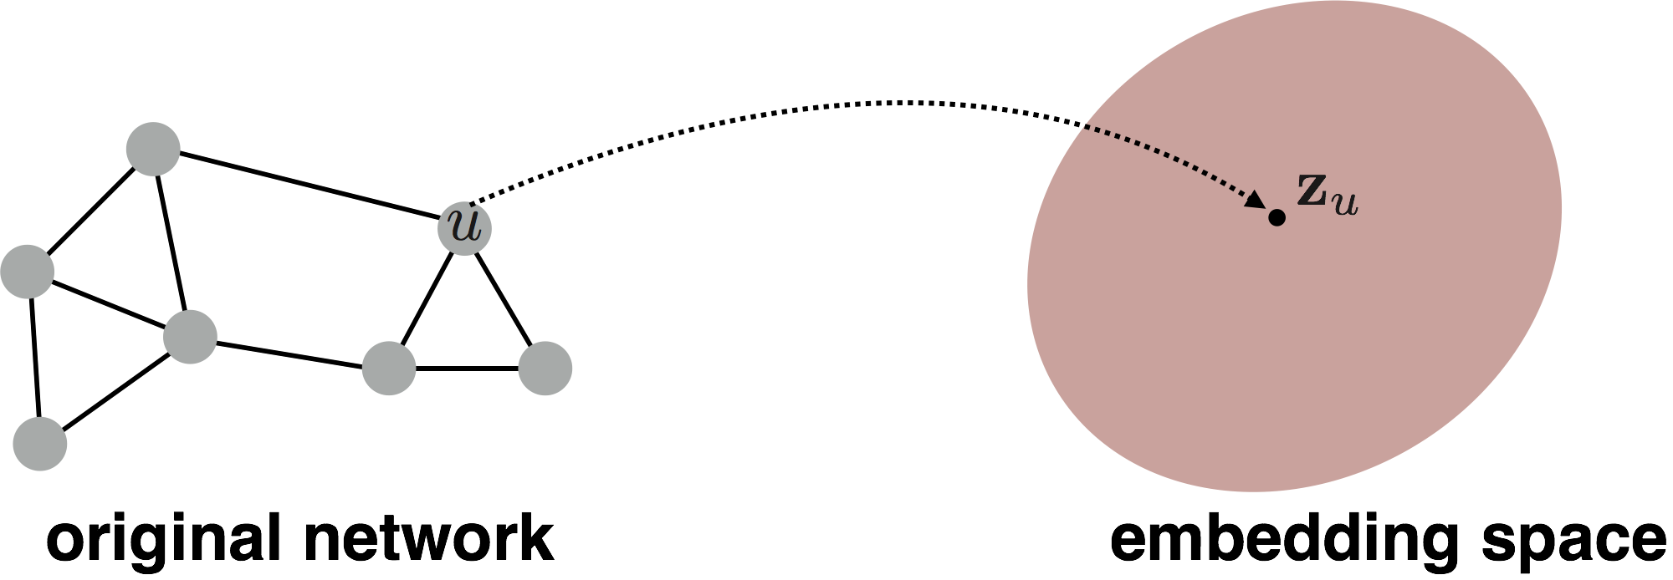
(Sub)graph Embeddings
So far we have focused on node-level embeddings…

Slide 63
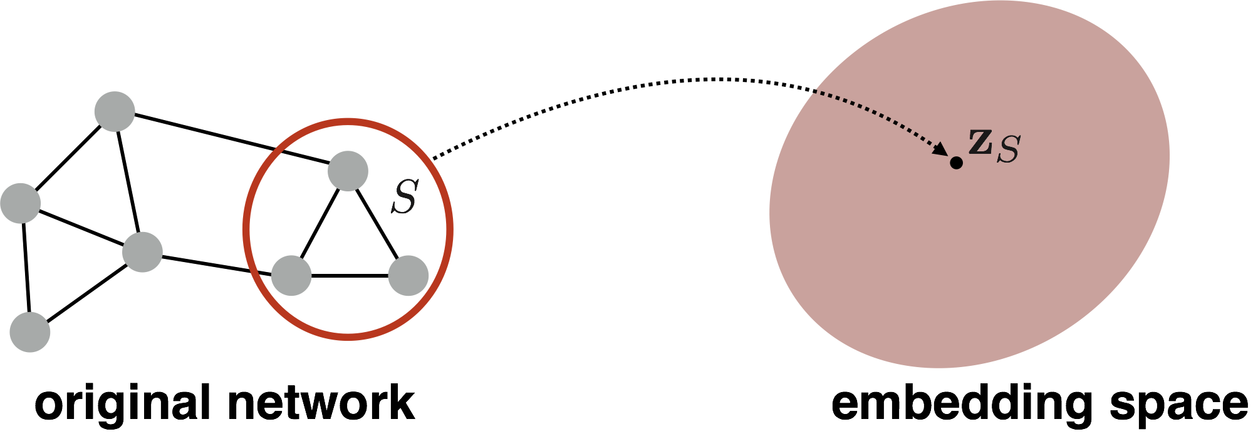
(Sub)graph Embeddings
But what about subgraph embeddings?

Slide 64
Approach 1
Simple idea: Just sum (or average) the node embeddings in the (sub)graph
Used by Duvenaud et al., 2016 to classify molecules based on their graph structure.

Slide 65

Approach 2
Idea: Introduce a “virtual node” to represent the subgraph and run a standard graph neural network.
Proposed by Li et al., 2016 as a general technique for subgraph embedding.

Slide 66
(Sub)graph Embeddings
Still an open research area!
How to embed (sub)graphs with millions or billions of nodes?
How to do analogue of CNN “pooling” on networks?

